Slide 1
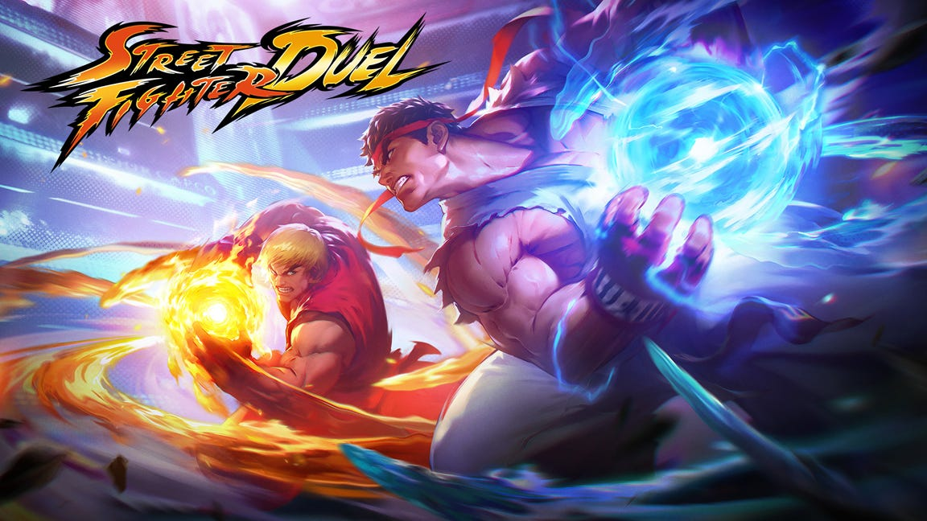

Slide 2
Overview
2D fighting game inspired by classic STREET FIGHTER.
Local and online multiplayer combat system.
Two playable characters (Ryu and Ken) with multiple maps.
Complete move set: punches, kicks, jumps, flips, blocks.
Sprite-based animation (20+ animations per character).
Frontend: JavaFX for UI and rendering.
Backend: Java with OOP principles.
Database: MySQL for user authentication and leaderboard.
Networking: UDP protocol for multiplayer synchronization.

Slide 3
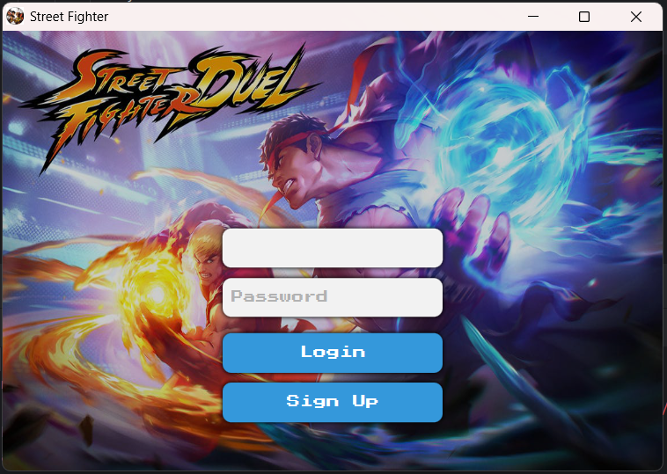
Login
LoginUIController.
User enters credentials.
DatabaseManager.loginPlayer().
SQL: SELECT * FROM players.
Success -> Navigate to HomeUI.

Slide 4
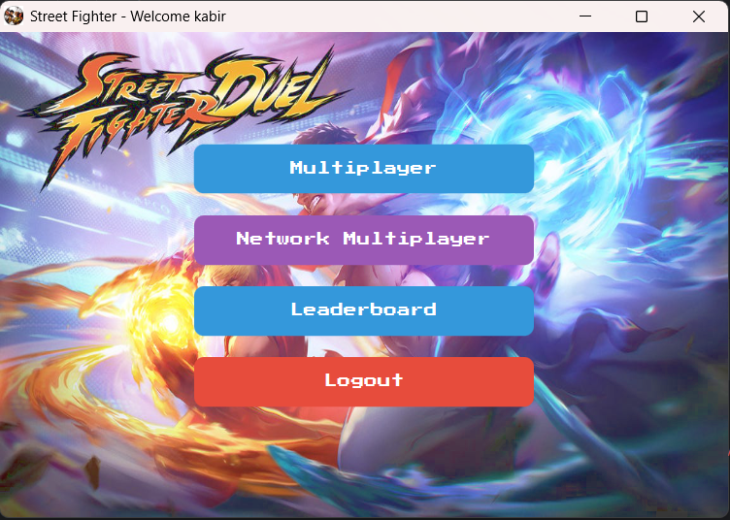
Home UI
HomeUiController.
Multiplayer: Same device two player.
Network Multiplayer: Two device under same wifi two player.
Leaderboard.
Log out.

Slide 5
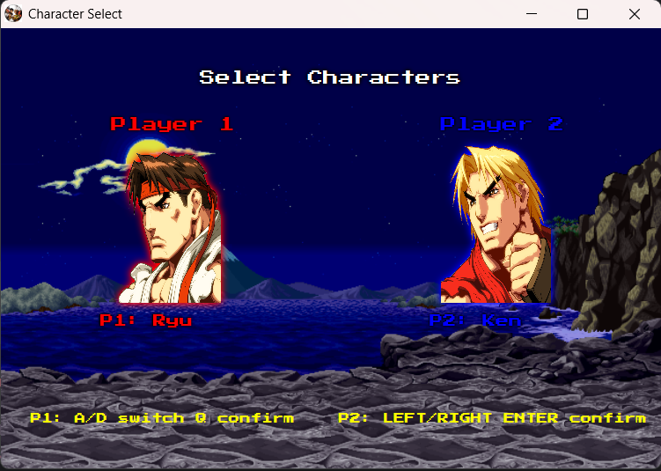
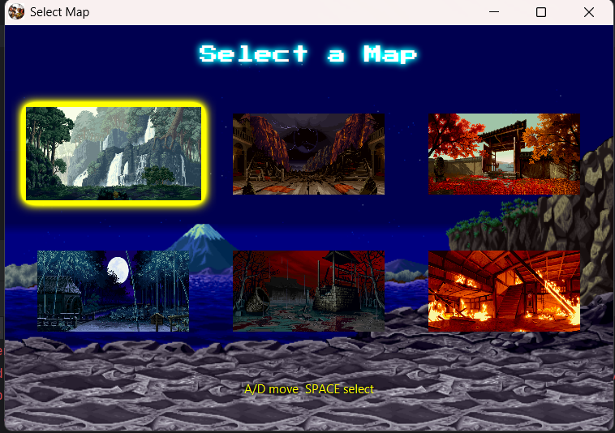
Multiplayer -> Champ and Map Select
ChampUiController .
MapUiController.
Select champ and map using keyboard.

Slide 6
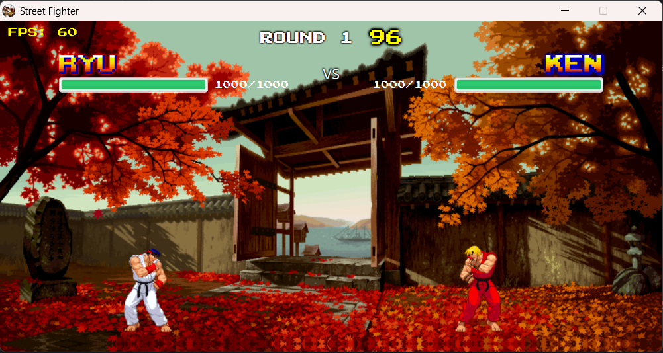
Game Scene and Flow
GameSceneController
Selected champ and map are loaded.
Flow: Login → Home(multiplayer) → ChampSelect → MapSelect → GameScene.
Game end -> Play again or Back to Home.
Leaderboard Updated.

Slide 7
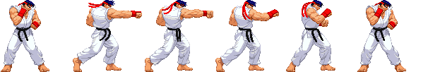
Asset Loading - Punch
ImageLoader.loadImage(punch.png).
SpriteSheet.crop(606, 102, x, y).
Assets.quick_punch[6 frames].
AssetManager stores animations.

Slide 8
[F] Key Pressed
GameScene detects F key.
InputManager.handleKeyPressed(F).
Fighter.processInput().
isActionPressed(punch) = TRUE.
Fighter.performAttack(QUICK_PUNCH).

Slide 9
Animation State Machine
AnimationSM.transition(PUNCH).
Create state: 6 frames, 100ms delay.
getCurrentFrame() calculates frame.
Returns Image from Assets array.
Fighter.render() draws on canvas.

Slide 10
Combat System
CombatSystem.getAttackData().
startup=1, active=3, recovery=2, damage=12.
Frame 2-4: Attack is active.
Hitbox for both players = 40x30.
getAttackHitbox() collision box.
if hit -> takeDamage(12).

Slide 11
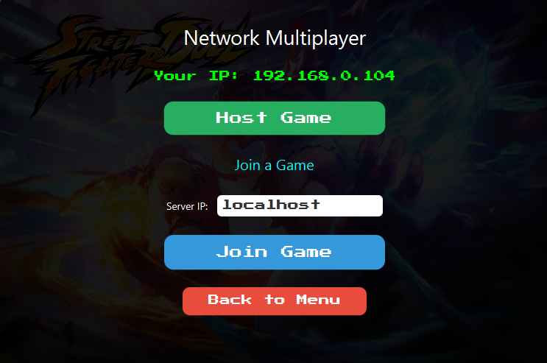
Network Multiplayer (Connection Setup)
Host starts NetworkGameServer on their machine (port 5555).
Client connects to host's IP address using NetworkClient.
Server stores both clients' addresses and port numbers.
Connection established via UDP DatagramSocket .

Slide 12
Input Capture & Packing
Player presses button (e.g., F for punch).
GameSceneController detects the keypress.
InputManager stores which buttons are pressed.
NetworkClient compresses 9 buttons into 16-bit number.

Slide 13
Send to Server
Every 16ms (60 times per second), send input to server.
Packet contains: which player + button data.
Uses UDP for speed (faster than TCP).

Slide 14
Server Broadcast
Server receives packet.
Immediately sends it to ALL players.
Server doesn't run game logic.
Just forwards messages.

Slide 15
Both Clients Simulate
Each player's game receives the input.
Both games run the SAME simulation.
Player 1's punch shows on both screens simultaneously.
Stays synchronized because same inputs = same results.
Packet lose < 2%.

Slide 16
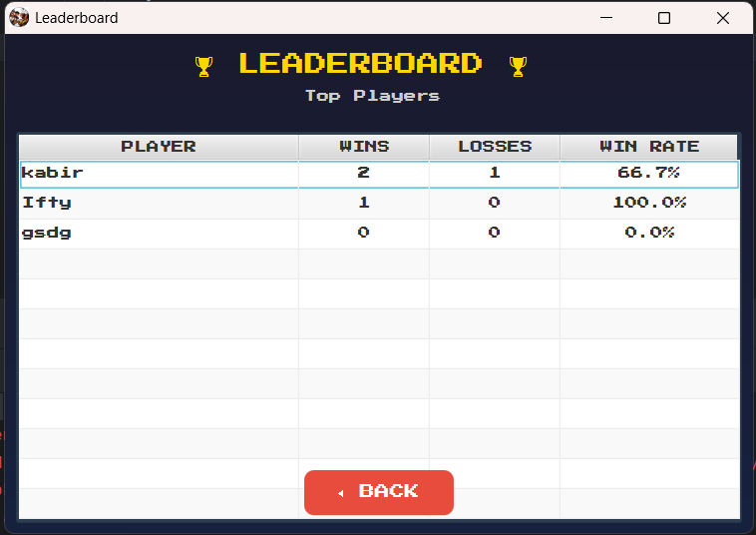
Database Update
Match ends->
checkWinConditions()
DatabaseManager.updatePlayerWin().
SQL: UPDATE players SET wins+1.
Leaderboard updated.

Slide 17
Thank You :v
Presented by
AL-FARHAN 112310262
Shabiha Tasnim 112330915
Miftahul Kabir 112310251

